Slide 1
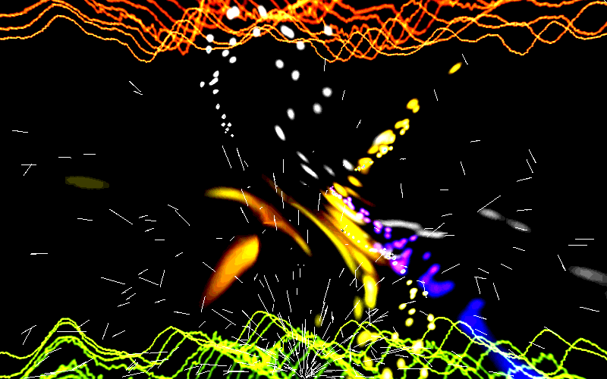
Congratulation my dear students

Slide 2
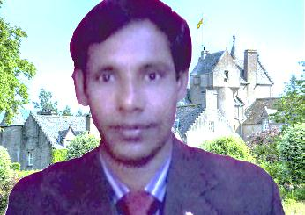

introduction
Md. Mafidul islam
English teacher
Taluksakhati High School
Kaligonj, Lalmonirhat
Email; mofidulislam094@gmail.com

Slide 3
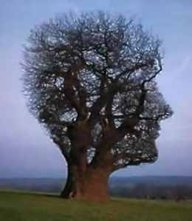
Subject;
English for today
Class; 8
Date; 01/08/2013

Slide 4
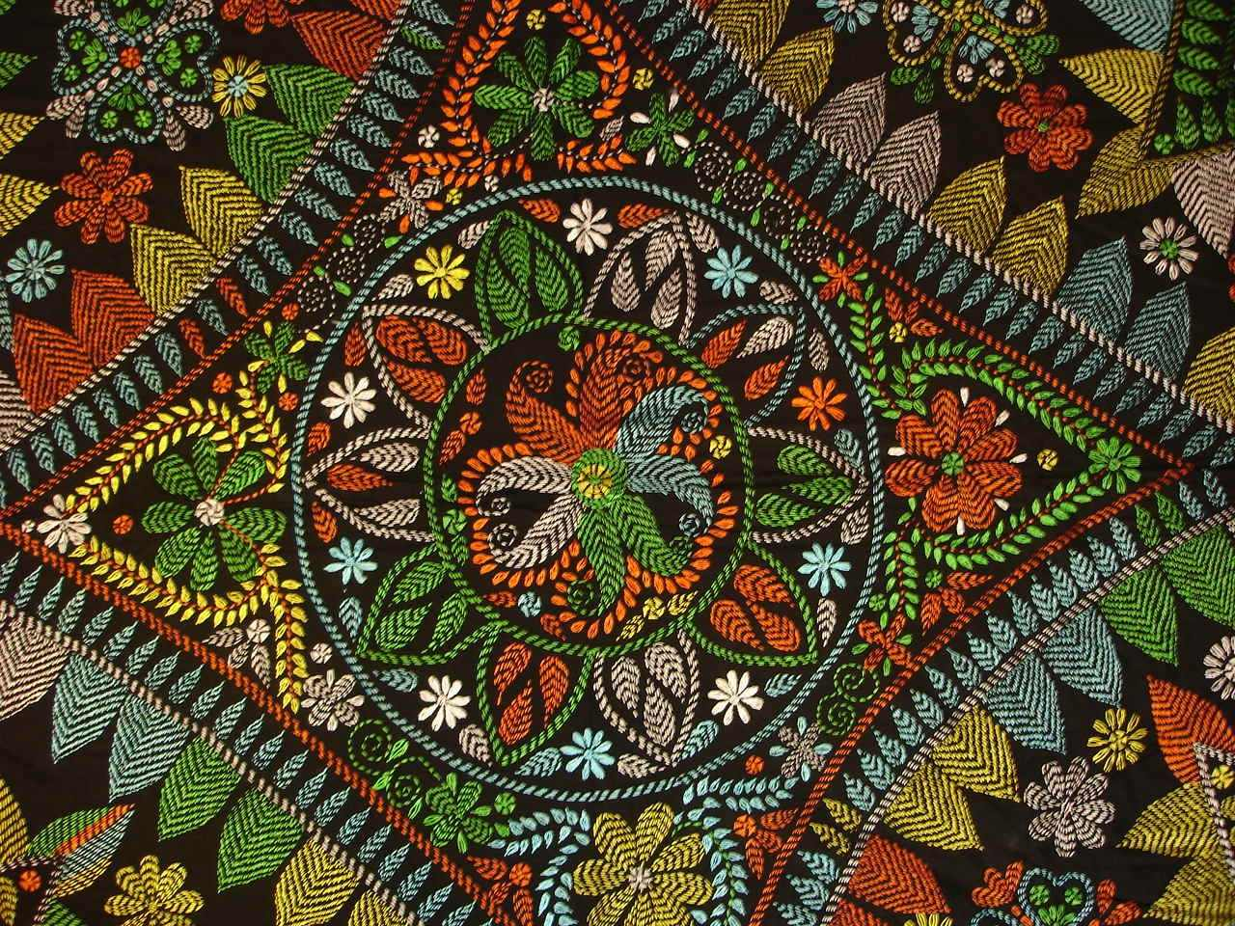
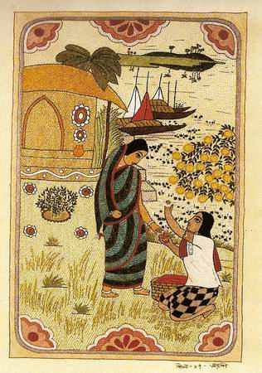
What do you see in the picture?
What is it called?

Slide 5
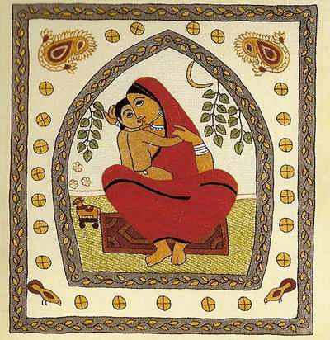
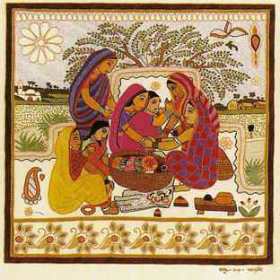
Think about the picyuret
Think about the picture?
What do we do with it?

Slide 6
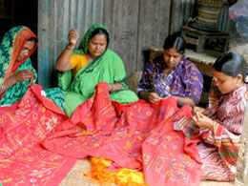
What are they doing?

Slide 7
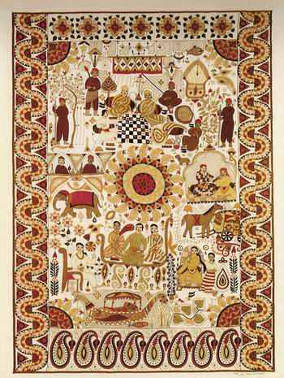
Have you seen it before? Where?

Slide 8

Topic name
Unit-Six, Lesson-2
Nakshi Kantha

Slide 9
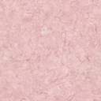

Learning outcome
After we have studied this unit, we will be able to;
Red and understand text through silent reading.
Infer meaning from context.
Write and answer question.
Write short compositions

Slide 10
Vocabulary
Quilt
A thick coverlet
Pattern
A model
A manual craft
Handicraft

Slide 11
Now read the text to know about nakshi kantha;
nakshi kantha is kind of embroidered quilt. The name was aken from the Bengali word, ‘naksha’ which means artistic pattern. It is kind of traditional craft and is said to be ----------------------------
Traditional kantha are made for family use. Old are new cloth and thread are used to make these quilts.

Slide 12
Individual work
Nakshi Kantha is our (a)--------tradition. The woman in rural Bangladesh have been making nakshi kantha for (b)--------------.It is (c)------------all over the country. But some areas are (d)------------------for it. The (e)-------------Nakshi Kantha, in fact, became very popular after publishing Jasimuddin’s (f)-----------’Nakshi kanthar math’ However, now khanta are made (g)---------------------. In the posh (h)----------------shops in cities now they are available. The (i)---------are now exported to many other countries of the world. They are in great (j)-------------.
Fill in the blank with suitable words from the text;
old
centuries
produced
famous
name
poem
commercially
handicraft
quilts
demand

Slide 13

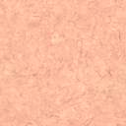
Pair work
Read the text again and make five sentences from the table;
Nakshi kantha Traditional kantha Old or new clothes and coloring threads Now a days kanthas We
Are used | For family used.
Are produced | To make these quilts.
is | Them in many expensive handicraft shops in cities.
Can find | A kind of embroidered quilt.
Are made | Commercially.

Slide 14

Answer
Nakshi kantha is a kind of embroidered quilt.
Traditional kanthas are made for family use.
Old or new clothes and colouring threads are used to make these quilts.
Now a days kanthas are produced commercially.
We can find them in many expensive handicraft shops in cities.

Slide 15

Evaluation
What does naksha mean?
Artistic designs
Where was the name taken from?
Bengali word
Which district of bangladesh is famous for nakshi kantha?
Jessore
What are used for making quilts?
Old or new cloth.

Slide 16
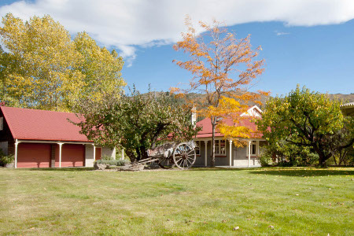
Home work
Write a paragraph describing how the Nakshi Kantha is made.

Slide 17
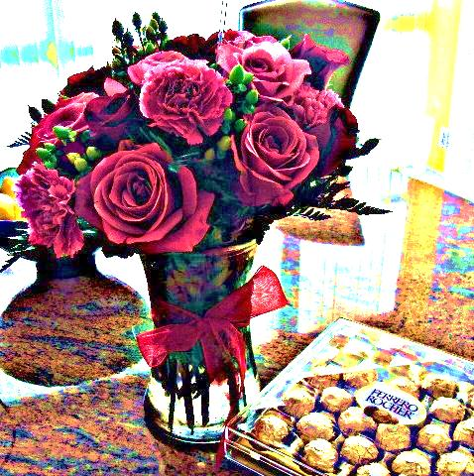
Thank you

